Slide 1
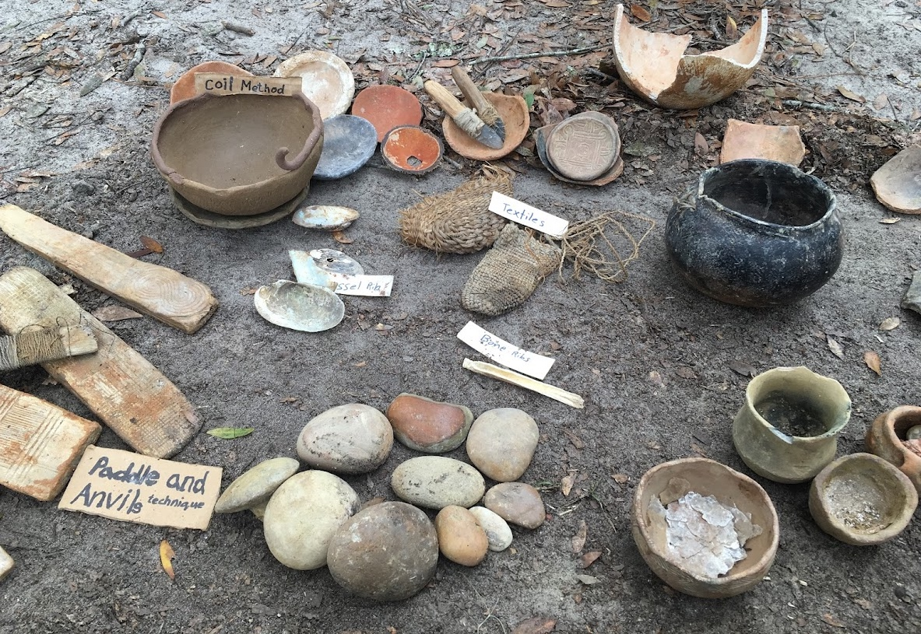
Compositional Analyses of Archaeological Pottery
Dr. Lindsay Bloch
Tempered Archaeological Services, LLC
DAACS
Notes:
Focus on elemental approaches, with some forays into replication and mineralogical approaches
Most of my projects involve multiple methods, for reasons I’ll explain.

Slide 2
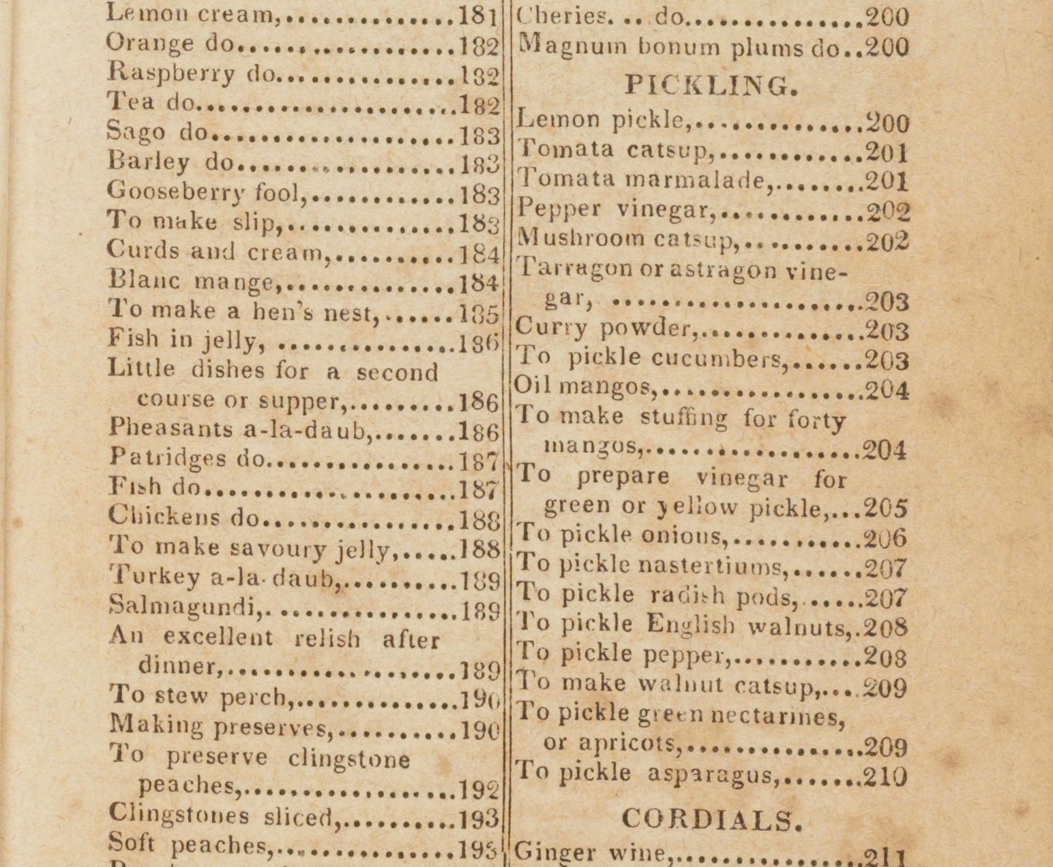
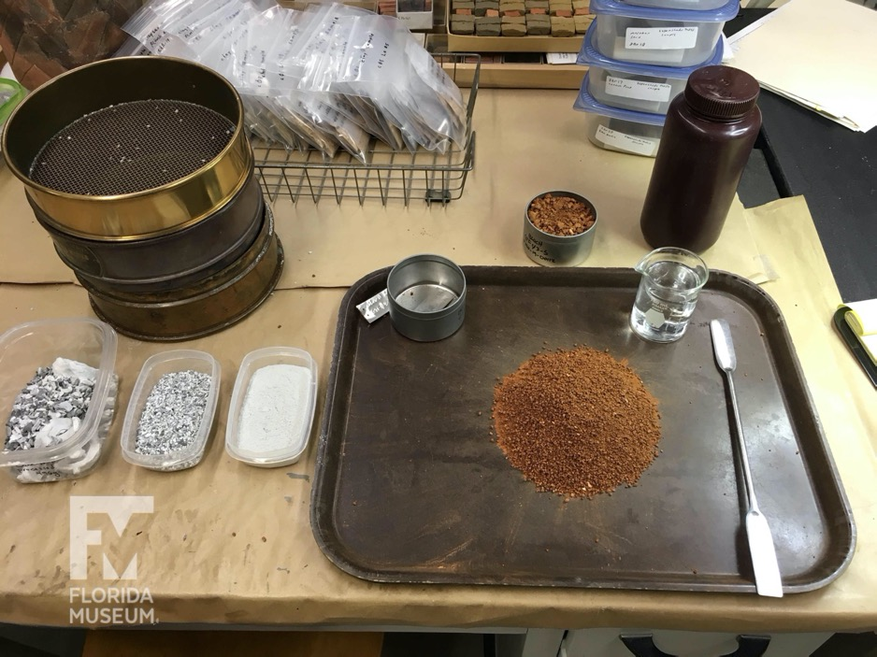
Recovering the Recipe
www.loc.gov/resource/rbc0001.2015pennell17897
Notes:
The instrumentation doesn't provide you with any context for the data it spits out.
In the research questions that I ask, I think more about the methods in terms of recipe. Recipes are contextual and social.
What I’m doing when I’m performing these technical analyses, is that I’m trying to recover the recipe of an artifact or a class of artifacts. I'm trying to put that material in a cultural context. In that way, a recipe is a way to recover human relationships in the past.

Slide 3
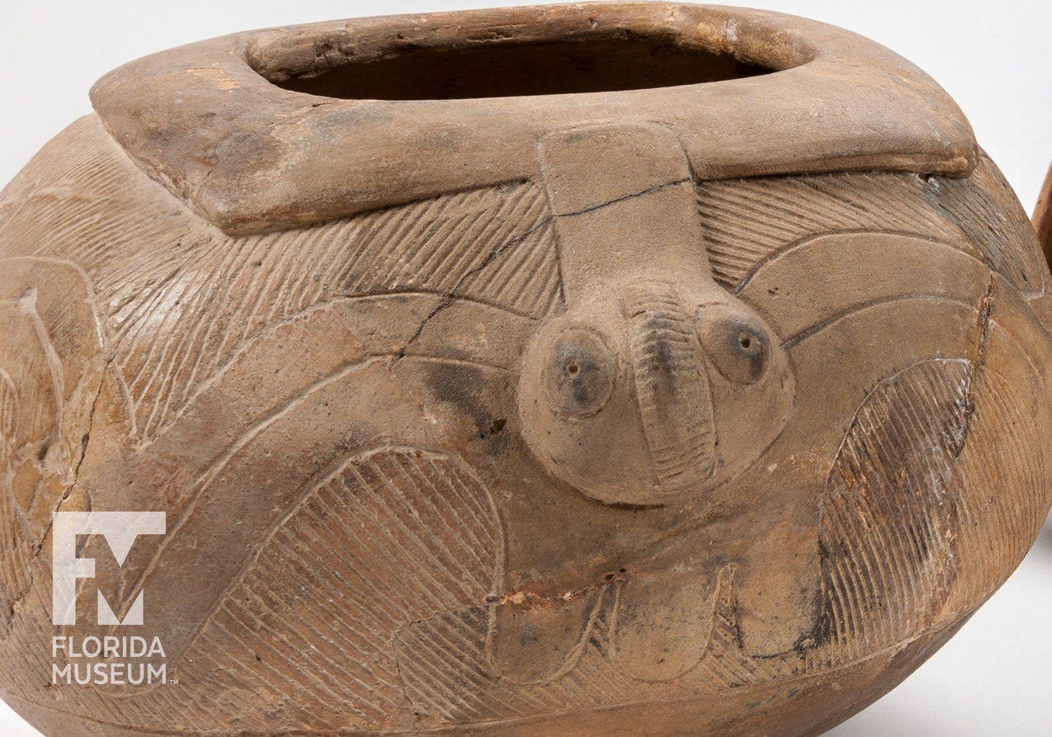
Recipes as Relationships
Environment
Movement and Trade
Cultural Learning
Notes:
There are three primary ways that I use these data within broader research frameworks. These often overlap.
Relationships between people and their environment, their landscape and the materials available. If I know what something is made of, I can tie it to what it was made from, and maybe where it was made. We usually refer to this work as sourcing. Tying an object back to a place based on shared geological fingerprint within the pottery, the rock, or other natural material.
The artifacts didn’t move themselves. If I know where something was made or where the origin material is from, and compare that to where it was found, then I have a way to connect people and their movement across the landscape over time. We can learn about cultural interactions, who was engaging with whom. Networks that may otherwise be invisible.
Relationships of learning in the past. If we understand the recipe of something, because a recipe is taught, we can learn how information was valued and shared within communities. Was there a standard or “right” recipe to follow? This is essentially a communities of practice approach that centers cultural knowledge and the way that it is shared and fixed into objects.
So yes, this technology tells us “what is it?” but it allows us to answer much more valuable questions. The methods are means to an end, and that end is to understand people better.

Slide 4
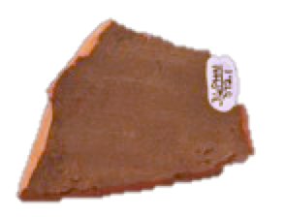
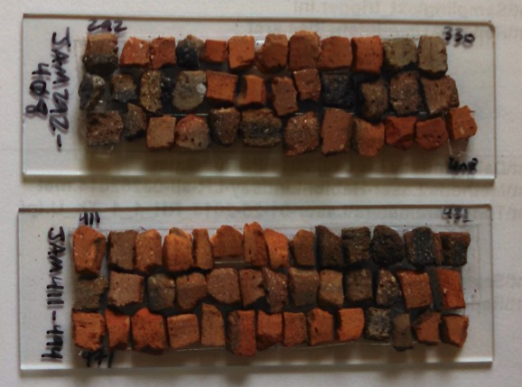
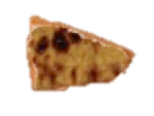
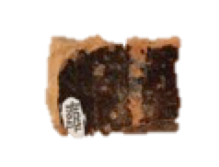
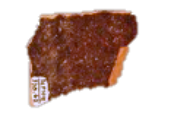
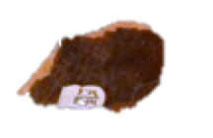
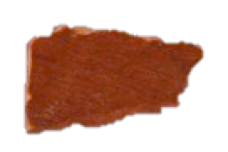
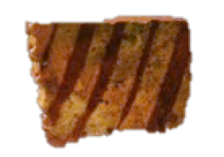
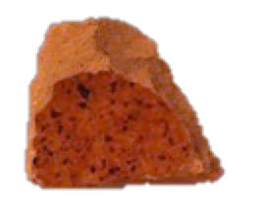
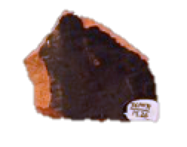
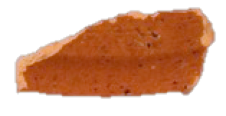
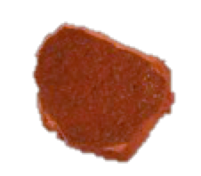
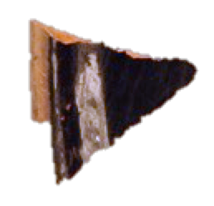
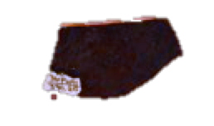
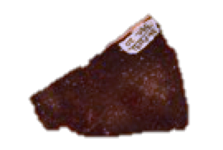
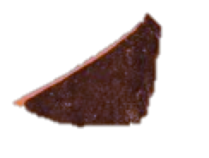
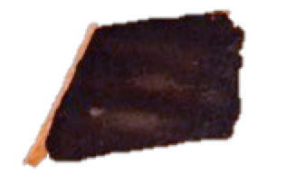
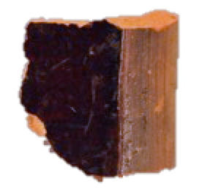
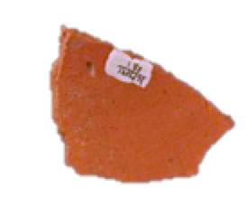
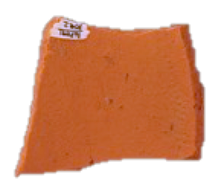
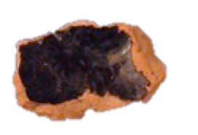
Compositional Attributes
VISIBLE
INVISIBLE
Firing conditions
Paste density and texture
Paste color(s)
Inclusions and voids
Glaze characteristics
Mineral composition
Paste
Inclusions
Elemental composition
Paste
Glaze
Inclusions
Notes:
Have already discussed visual characteristics (CEW lecture).
Next, let’s consider the composition at a more fundamental level.
This can include the mineral composition of paste or inclusions.
Around 700 degrees C, clay minerals begin to melt and reform, making their identification tricky or impossible for historic earthenwares. Native American pottery was often fired below this threshold.
Heat resistant inclusions can be identified using methods such as petrography, but there is a steep learning curve and other limitations.
However, I’ll be speaking today about elemental analysis.
There are three primary methods that have been used on historic earthenwares: Neutron Activation, XRF, and LA-ICP-MS, I use all three in my research, in concert with mineralogical and macroscopic techniques.

Slide 5
BULK
GC-MS
NAA
FTIR
XRD
COMPOUND
(Minerals, molecules, etc.)
ELEMENTAL
XRF
Optical Mineralogy
ISOTOPIC
ICP-MS
IRMS
PIXE
POINT
Notes:
2 main distinctions among common compositional analysis techniques
Scale: whether your sample is Bulk or point. It’s really a question of what your samples look like. If you’re measuring a sample or a part of a sample that has internal homogeneity it is a point technique. For example, measuring different swatches of paint on a painting, would be a point technique. If you’re measuring something that is internally heterogeneous, like a granite rock, it’s a bulk technique because it is going to give you the average concentration of all the minerals present within the sample area.
Also need to consider bulk or point depending on the matrix and whether we are getting a surface measurement or one that extends into the sample.

Slide 6
The Alphabet Rundown
Method | Name | Destructive? | Best for:
XRF | X-Ray Fluorescence Spectrometry | No* | Elemental Composition of metal and glass
NAA | Neutron Activation Analysis | Yes | Elemental composition of soils and silicates
ICP-MS | Mass Spectrometry | Yes* | Elemental or Isotopic composition of many things
XRD | X-Ray Diffraction | Yes | Mineral composition of ceramics and geological materials
LIBS | Laser-Induced Breakdown Spectroscopy | No* | Metal Alloys, composite materials
SEM | Scanning Electron Microscopy | Yes | Micromorphology, elemental analysis (when coupled with XRF)

Slide 7
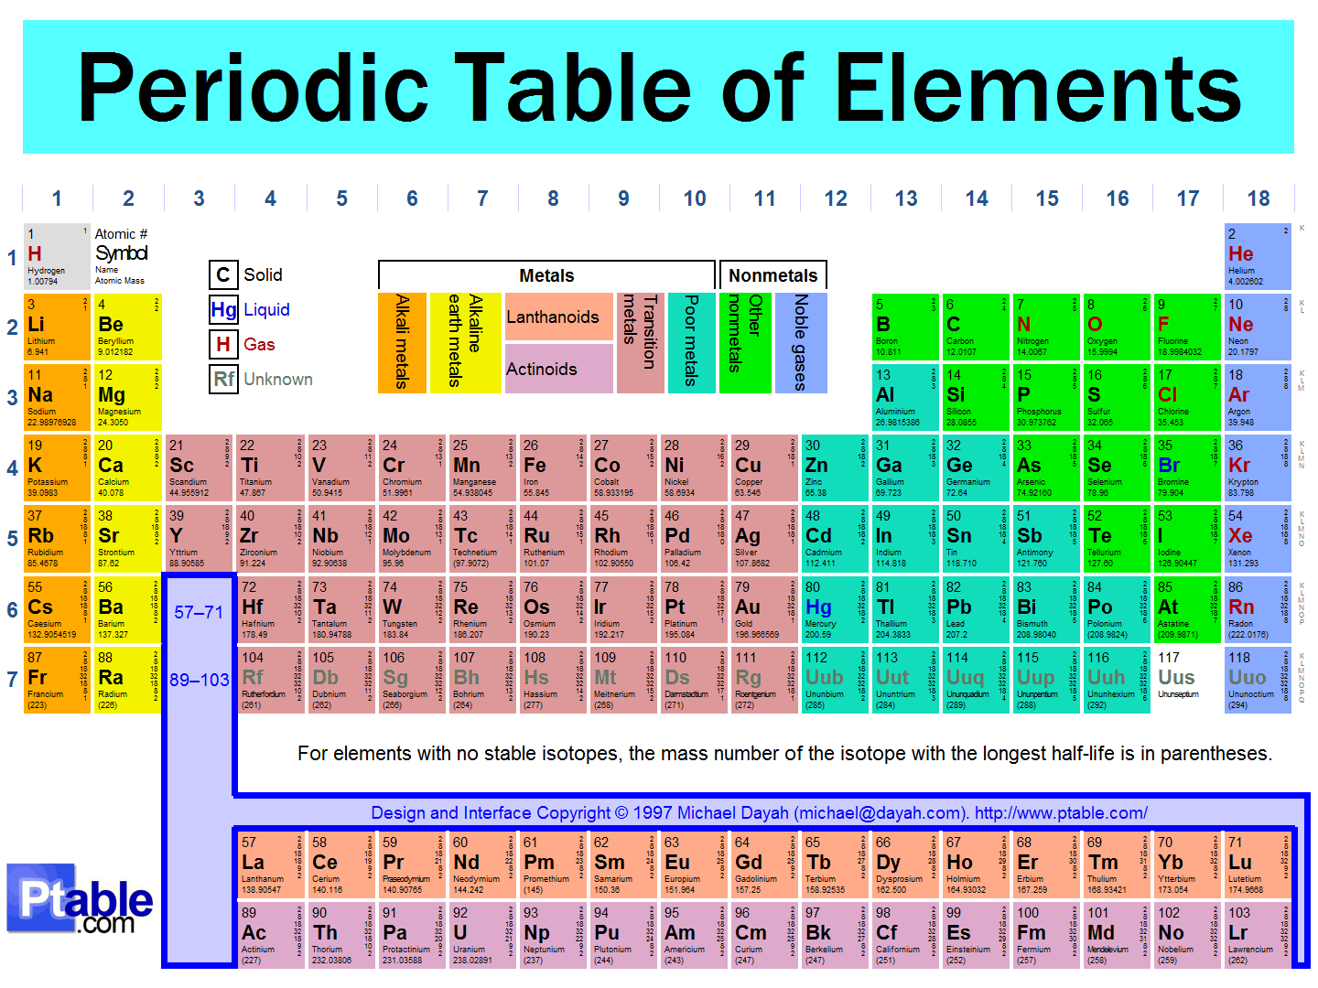
Elemental analysis
Notes:
When I say elemental analysis, what do I mean?
In this process of elemental analysis, a solid sample: a piece of rock, or pottery, or glass, etc, is broken down to identify its fundamental building blocks: atoms.
Some elemental analyses are even more specific: isotopes. Isotopes are different versions of an element, that have different masses. When I say element, today, I usually include isotopes, within that.

Slide 8
Research Design
What do you want to know?
Is destructive testing a possibility?
How large are your samples?
Are there preservation issues?
Notes:
Machines are dumb. They are just going to do what you tell them to do. In order to tell them the right thing to do, you need to have clearly defined goals.
If you can’t do destructive testing, you have different methods available
Some materials have size limits- they would be entirely consumed by some destructive testing, or are too thin, etc. for appropriate analysis.
Provenience, taphonomy, and curation practice is really important to understand when you're interpreting your results.

Slide 9
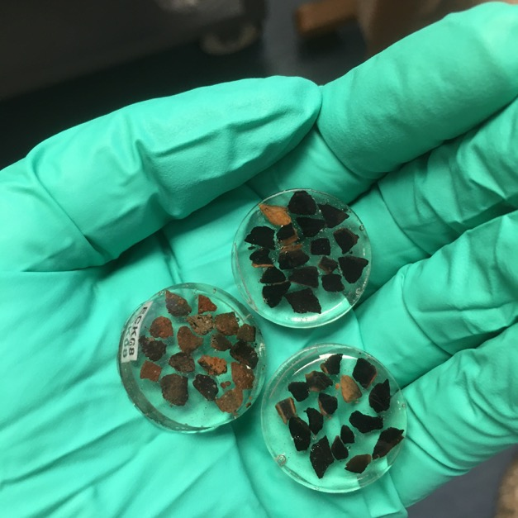
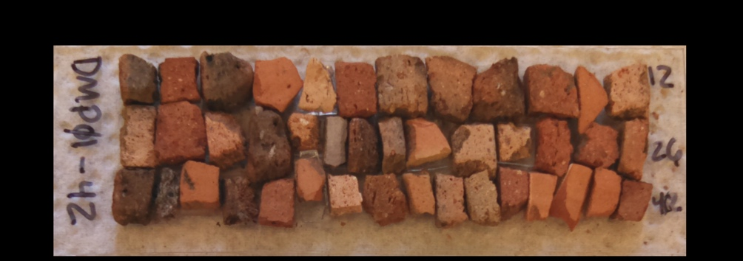

Samples
Notes:
Archaeological materials are unique and non-renewable. The best method is the one that is the least destructive and yields the best data for a particular research question. I’m going to briefly talk about the three main primary elemental methods from least destructive to most destructive. I’ll then show you a longer case study that incorporates multiple methods.

Slide 10
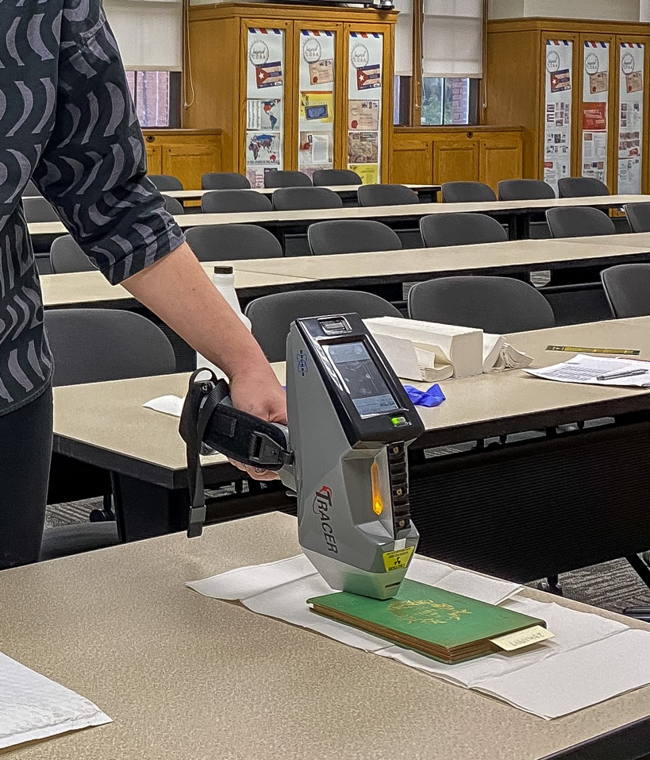
Types of Analyses
Qualitative
Element Presence/Absence
Direct Comparison
Notes:
Now I’m going to run through a few brief case studies, from basic to complex. Back to that first question- what do you want to know?
This is qualitative, but can be incredibly useful.
Is there a material that is hazardous?
Is there a temporally sensitive ingredient? Certain kinds of paints weren’t used until certain dates, for example.
The presence of a specific alloy may be temporal.
Here, I am analyzing a 19th century book for the presence of arsenical green colorant.

Slide 11
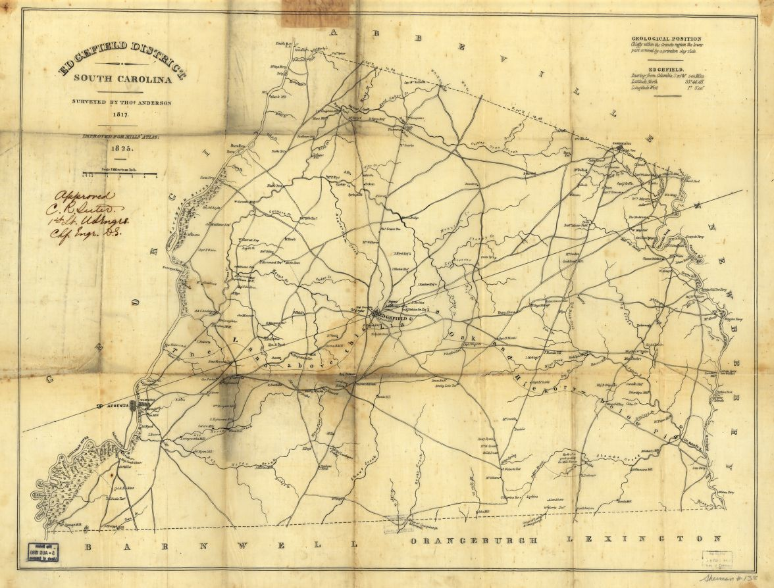
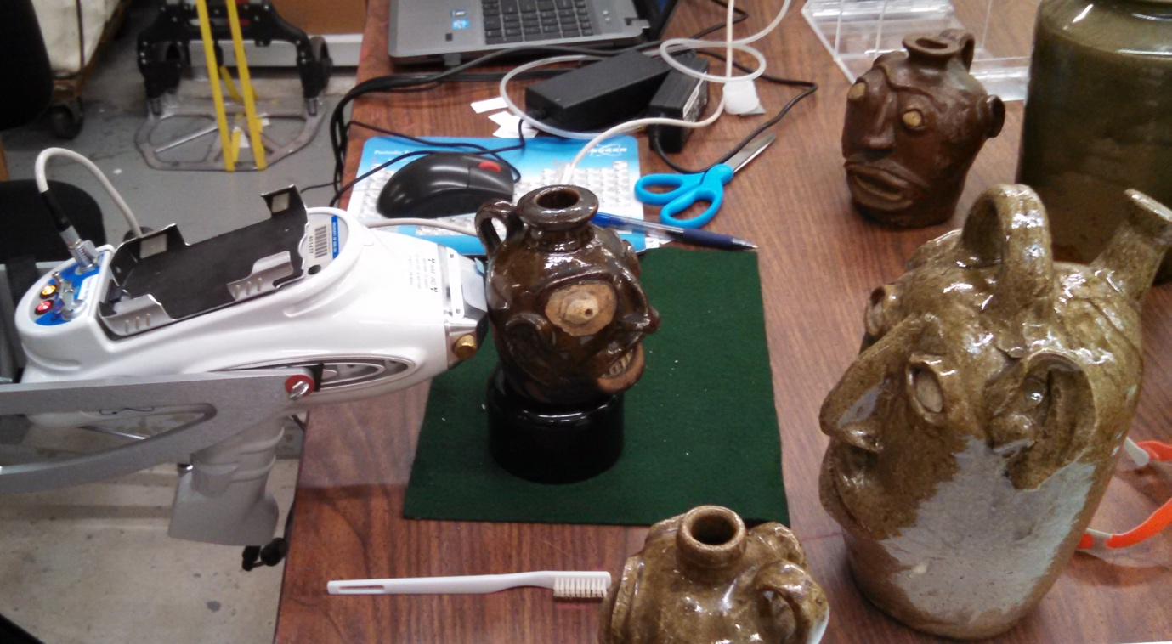
Elemental Sourcing- X-ray Fluorescence spectrometry
Notes:
To conduct this analysis, I used portable X-ray fluorescence spectrometry. I won’t go into the specifics of how this works here, but will be happy to answer any questions you may have. Essentially, it’s a non-destructive technique, using this thing that looks like a ray gun, and is a ray gun. It shoots X-rays at the surface, and depending on what the object is made of, different X-rays come back, which the instrument measures. This provides the elemental composition, the chemical fingerprint, of an object, which as I just explained, is related to the clay and thus the geographic region where it was made.

Slide 12
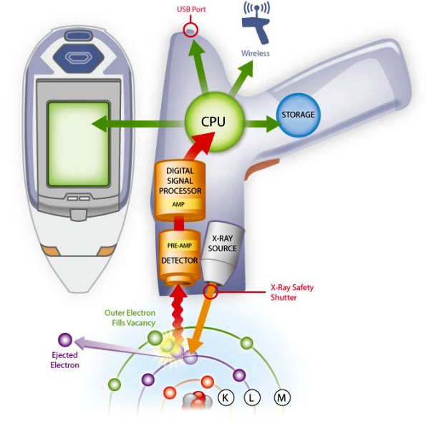
XRF Guts
Notes:
First let’s put all the pieces together:
X-ray source: in this case it is a rhodium x-ray source. Essentially it’s a specialized lightbulb. Instead of producing energy in the form of visible light, it produces energy in the form of soft X-rays. There is no inherently radioactive element in the device.
When the instrument is turned on, the X-rays interact with the sample, producing secondary X-rays. This is fluorescence. See here another diagram of the x-ray ejecting an electron and another one taking its place.
The resulting characteristic X-rays shoot back into the instrument as photons, hitting the X-ray detector. This is the energy dispersive spectrometer. As the photons reach the detector, they are counted and sorted by energy.
These data passes into the computer inside the instrument. We can see on the instrument itself or on an external computer.

Slide 13
Whiteware/Ironstone glaze v. Pearlware glaze
Whiteware/Ironstone
Pearlware
Notes:
High lead peaks (blue) show that the pearlware has a pure lead glaze, while lower values for whiteware/ironstone sherd indicate that the glaze is alkaline/lead.

Slide 14
Creamware glaze v. Pearlware glaze
Creamware
Pearlware
Notes:
Can see the colorants too for pearlware and creamware glazes
Creamware elevated in iron (makes yellow tint)
Pearlware elevated in cobalt and copper. (makes bluish/green tint).

Slide 15
Types of Studies
Element Presence/Absence
Qualitative
Direct Comparison
Qualitative
Quantitative/Semi-Quantitative Analyses
raw counts
ppm/wt%
Notes:
As you can see, these quick qualitative analyses often bring up larger research questions that are best addressed with quantitative analyses
Quantitative analyses require a lot more preparation and thought
-many samples
Establishing values for different elements within samples
Identifying patterns in compositional variation
Putting boundaries on the compositional universe
Questions about:
Sourcing
Recipe- that can include metal alloys, glass bead colors, pottery, etc.
Contamination

Slide 16
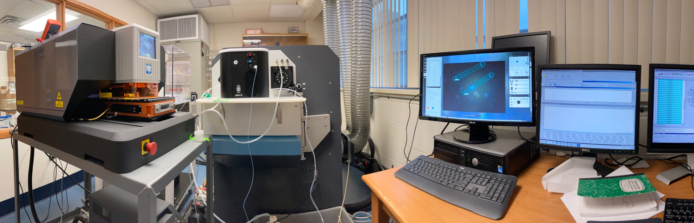
LA-ICP-MS Laser Ablation-Inductively Coupled Plasma-Mass Spectrometry
Notes:
This is the instrument setup. From left to right we have the laser ablation system, the inductively coupled plasma mass spectrometer, and then on the right, a whole bunch of computers that run the instruments and help them talk to each other.
This work can only happen in a laboratory. In addition to the very expensive instruments, you need different gases, including helium and argon, special ventilation and air handling, and climate control to keep the instruments from overheating. They are very finicky. Laser ablation facilities are usually in universities or large analytically minded institutions like museums or testing facilities.
Laser ablation is the sampling method. It’s how we get your material to the mass spectrometer for identification.
So you place your samples in the chamber. I put in standard reference material too, things that I already know the composition of, so that I develop a calibration at the end and get good quantitative values. parts per million values.
The chamber is sealed and there is helium gas flowing through it. So then you decide what part of the sample you want to analyze. To do this, you use the integrated camera. This is where laser ablation really shines, because you can pinpoint exactly what you want to analyze, and avoid things you don’t want to include. Ablation means to remove by cutting or abrading. In this case, that removal is done by a targeted laser beam, vaporizing part of the sample. The laser is set to particular energy and speed depending on the kind of material you’re sampling. If it’s very soft, you want a lower power so you don’t make big craters.
Now we move on to the inductively coupled plasma. Or ICP. This is also called the ionization stage. To get there, your vaporized sample is suspended in helium gas and very gently sucked up through the system until it reaches the plasma torch. The plasma torch is very special kind of combustion, in a package about the size of a hot dog . An electromagnetic coil wrapped around a tube heats up a gas, in this case argon to a temperature at which is ionizes (so the electrons on the atoms are moving around) and the gas becomes electrically conductive plasma. A similar process, at lower temperature is happening in your plasma tv screen, or in a neon sign.
This plasma torch is very very hot, about 7,000 kelvin = 12,000 F. What that ionization, or plasma means, is that as our sample passes through it, it pulls our vaporized sample apart into individual atoms, or isotopes. You use the software to tell the mass spectrometer what elements or isotopes you’re interested in. You can look for most elements with mass spec, more so than with methods like neutron activation and XRF. I usually scan for 55 different elements, including major elements such as silicon and aluminum, and trace elements like lead and uranium. With metals in particular, some researchers may be interested in different isotopes of the same element, say multiple versions of lead, but I don't need that kind of resolution for the work that I do. Your atomized sample then passes out of the plasma torch, into the mass spectrometer, where a series of magnets filter the individual atoms according to their mass. Individual isotope masses are unique, so tied to a particular element. As these atoms come through, the mass spec is just sorting and counting.
Then all your work shifts to the data files that are created. all of the counts by mass that are identified to specific elements

Slide 17
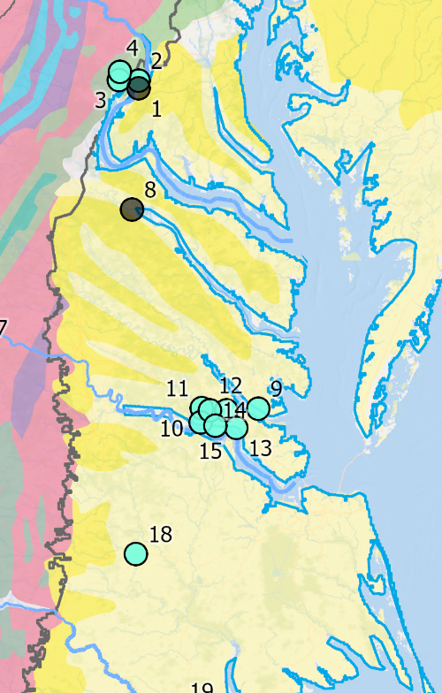
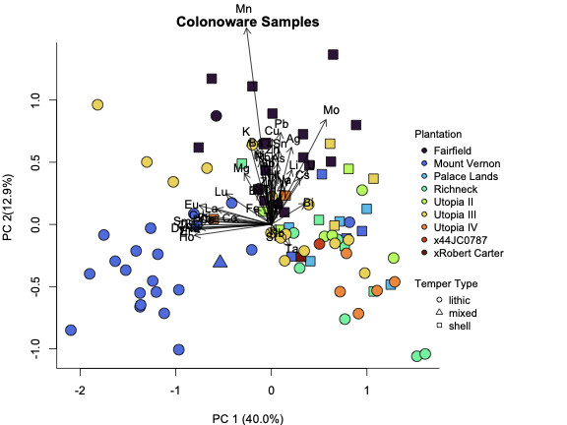
1st Round LA-ICP-MS, VA Colonoware
Notes:
Data on many isotopes, we look at 55 or so different ones. Here’s some results for our Colonoware research. Each dot is a ceramic sample, color coded by site. Mainly site-based clustering indicating local production in different parts of coastal plain of Virginia.

Slide 18
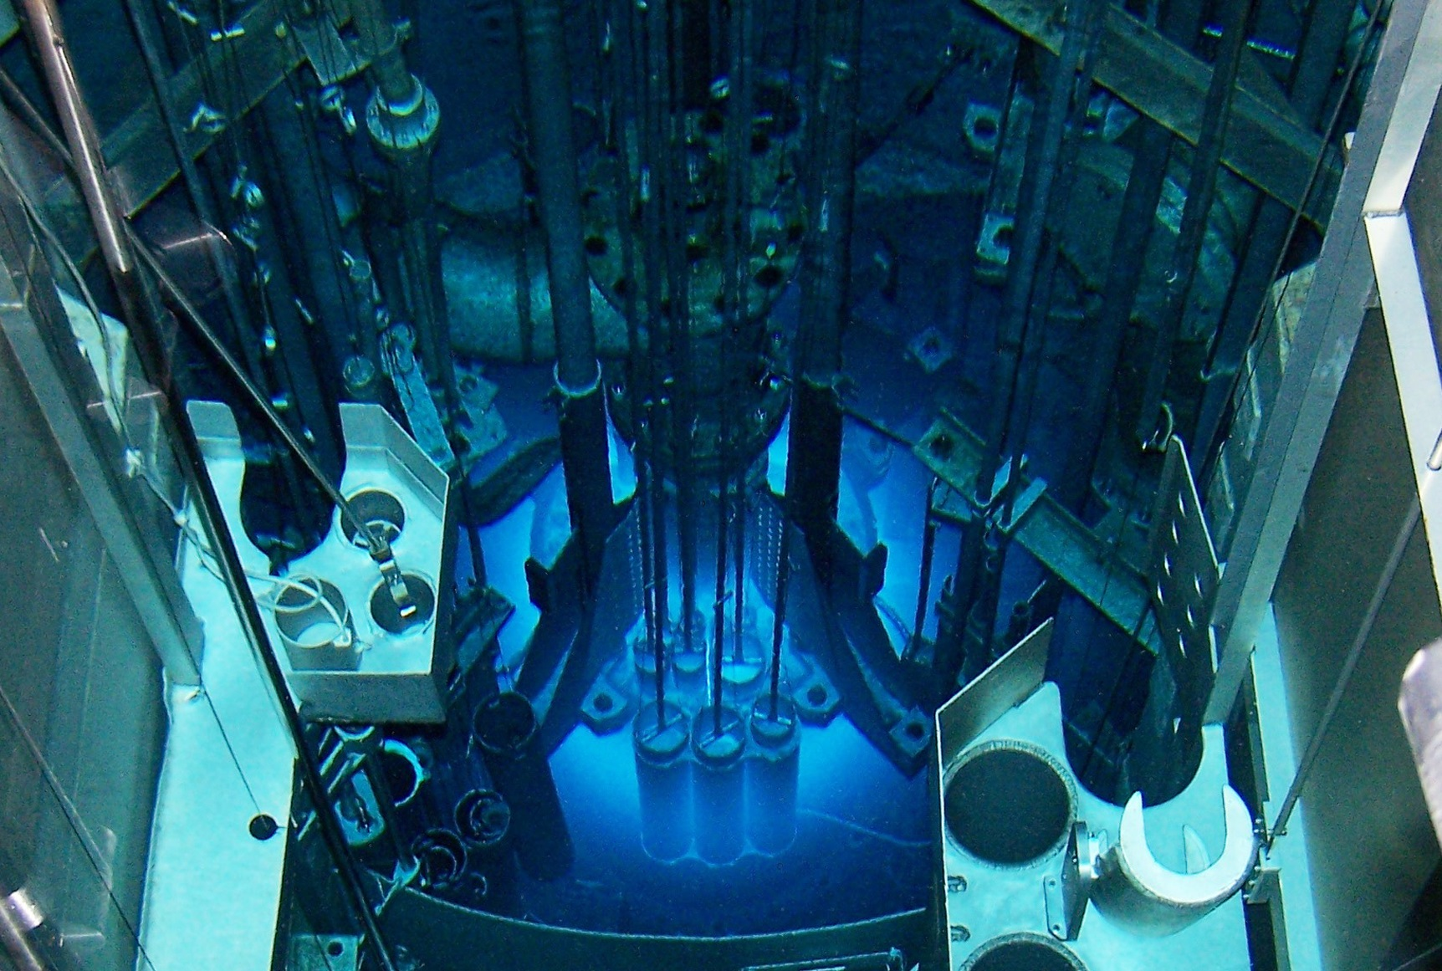
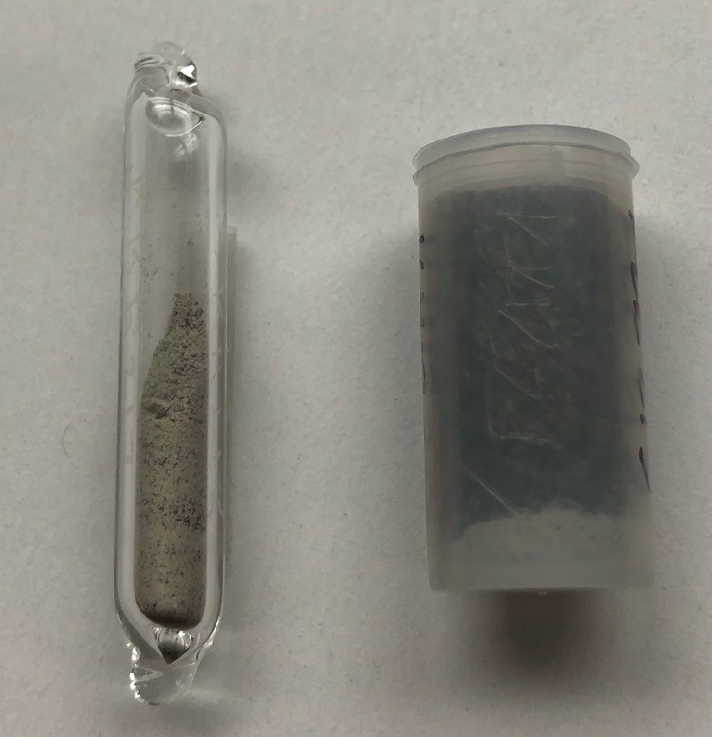
Neutron Activation Analysis
What is a sample made of, at an elemental level?
Notes:
This is a destructive technique, though the piece needed is relatively small. We start by breaking off a small piece of pottery.
Neutron activation analysis or NAA, is highly specialized and can only be conducted at a few institutions because it requires the use of a research nuclear reactor. Our project uses a reactor housed at the University of Missouri.
We send our pottery fragments to this lab. They powder them and put them into tubes, as seen here.
Then, the tubes get bombarded with nuclear radiation. The atoms in the sample respond to the radiation in characteristic ways, putting out their own radiation, which is measured by the instrument. These measurements are used to identify the composition of the pottery in terms of percentages of 33 different elements: A sample may come back as 30 percent aluminum, 5 percent iron, and so on.
Once we have those values, for lots of samples, we can start to put the data together and see what the patterns are.

Slide 19
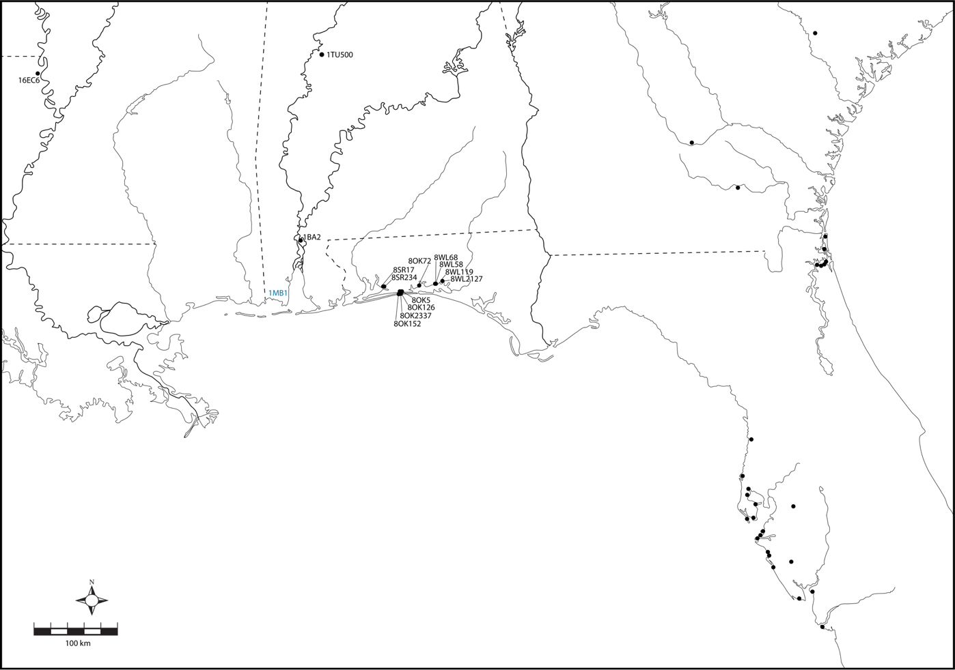
Pensacola Pottery
Moundville:
N = 80
(Salberg 2013)
Lake Providence:
N = 39
(Weinstein 2005)
NE Florida/SE Georgia
N = 116
(Ashley et al. 2015)
Choctawhatchee Bay:
N = 39
Tampa Bay:
N = 303
(Duke et al. 2023;
Wallis et al. 2023)
Bottle Creek:
N = 61
Notes:
For this project, we employ NAA with two goals in mind: first, we want to identify groups of pots that share the same elemental fingerprint that can be tied to a specific region: where are the clays coming from that people are using to make pottery? And second, we want to figure out if pottery was moving around, as a way to understand how people were moving around and interacting in the past. Looking for a mismatch between where a pot was found and where it was made. These two goals help us to identify pottery making in communities, and to begin untangling the relationships among Pensacola people across this big region.
Next slide shows the results of our first 100 NAA samples of Pensacola pottery. 61 were from the site of Bottle Creek. Bottle Creek, in the Mobile-Tensaw delta is widely regarded as the principal town of the Pensacola culture. The remaining 39 were from Choctawhatchee Bay in West Florida. We use existing NAA datasets from the region to help establish source locations and fingerprints, and we used 538 of those existing samples. This map shows the general locations of the existing samples.

Slide 20

Results
?
Notes:
Here are some initial results. The plot on the left is a principal components analysis plot, that helps to visualize the many dimensions of the elemental data in just two dimensions. NAA provides results on 33 different elements. But it is very hard to think about, much less represent 33 dimensions. This is a way to see it in two. Each dot represents one of our samples. The main thing to remember when interpreting these plots, is that the dots that are closer together are more related than dots that are further apart. We’ve color coded them here on the plot, based on some underlying statistics. When they share a fingerprint, they share a color.
Our NAA results were excellent, showing clear divisions among different source groups. This plot actually shows inverted geography, with western groups plotting on the right, eastern groups on the left, and central groups in the middle. From this initial view, we could see that it would be possible to tell the difference between a pot made at Moundville from a pot made at Bottle Creek, or in Choctawhatchee Bay, or along the Mississippi River to the west.

Slide 21
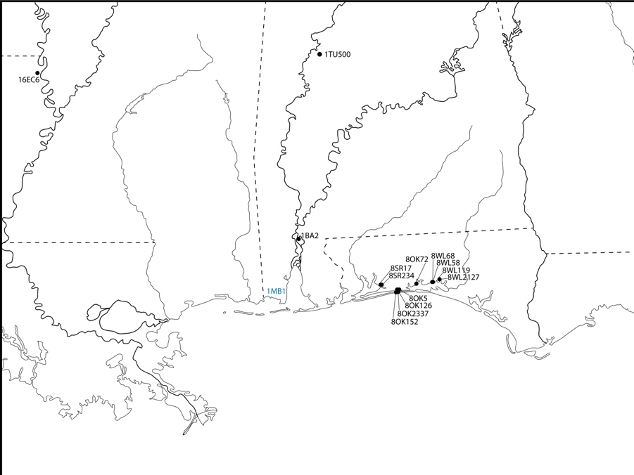
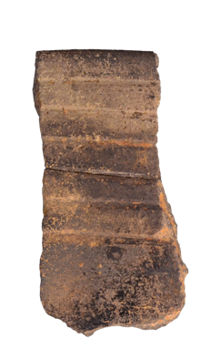
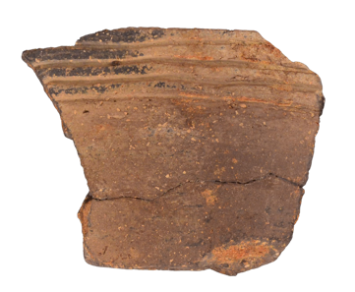
Results
?
LMV 1:
5 samples
recovered from
Bottle Creek
5 cm
Notes:
Five sherds recovered from Bottle Creek fall into the Lower Mississippi Valley 1 group – so these are non-local, and they look non-local - these are all grog-tempered types that we typically associate with the Lower Mississippi Valley, [SLIDE]. So, we think these pots are traveling from the Lower Mississippi Valley with people who are coming to Bottle Creek. [SLIDE] Significantly, these nonlocal sherds span the period of Bottle Creek’s occupation, indicating that this relationship with Lower Mississippi Valley potters began early in Bottle Creek’s history, and continued throughout its occupation.

Slide 22
“when any of their fires happened to be extinguished through chance, or negligence, it was necessary to kindle them again at theirs [the Maubilians]” (Charlevoix in O’Neill 1977:154).
?
5 cm
Notes:
In fact, there’s a glimpse of this relationship in the 18th century French documents - in the 1730s, the Frenchman Charlevoix reported that when the fires of the Natchez Indians went out, it was necessary that they travel 400 km from the Lower Mississippi Valley to Mobile Bay, likely to the site of Bottle Creek, in order to rekindle them. It’s very exciting for us to see some archaeological evidence for this movement of people.

Slide 23
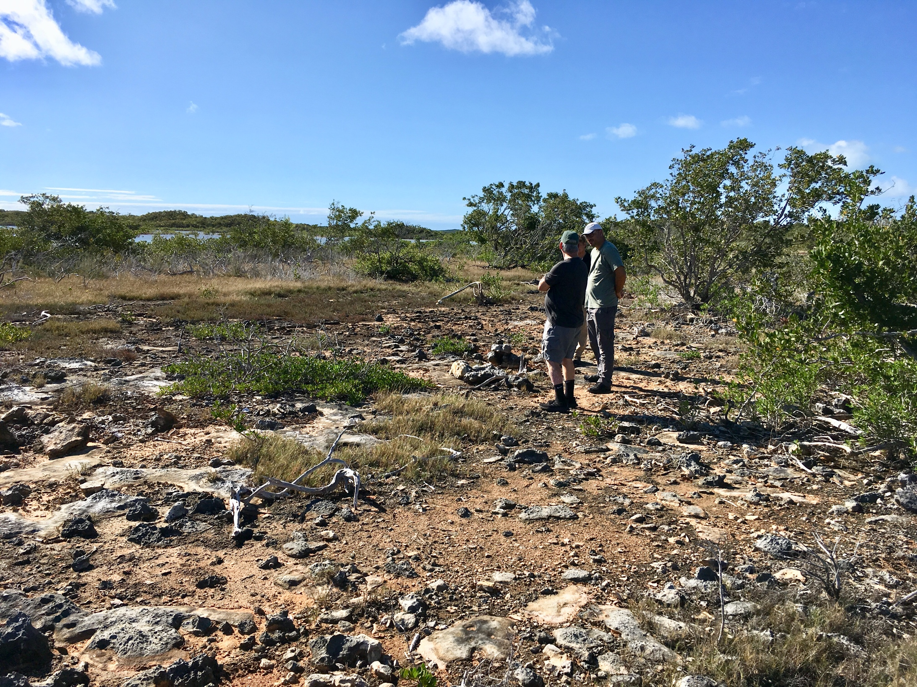
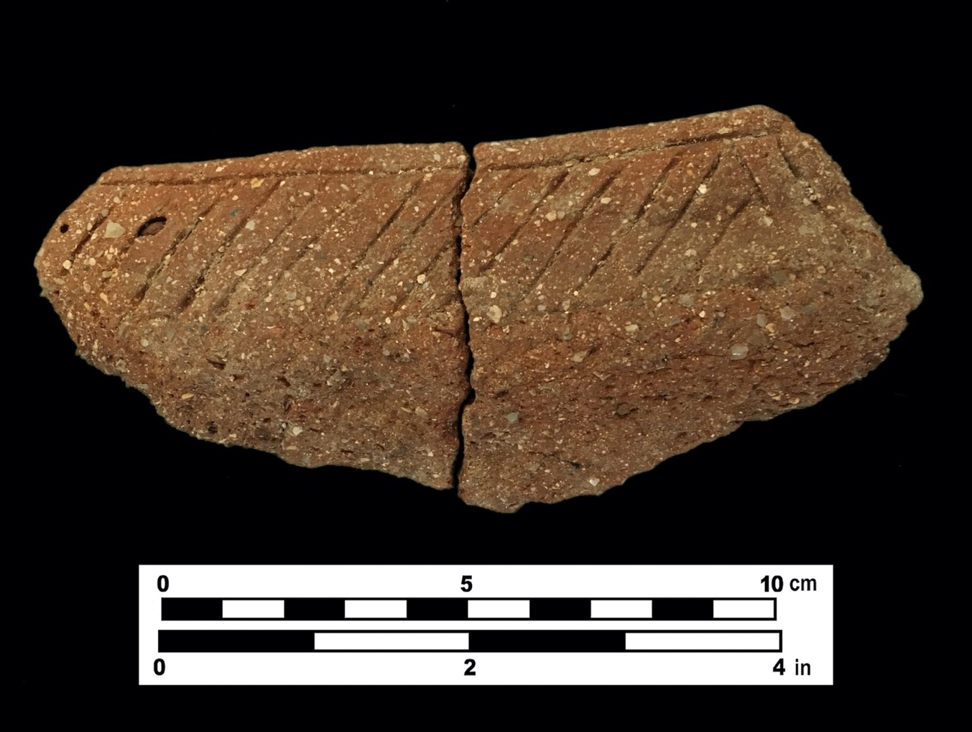
Palmetto Ware Pottery: Reverse Engineering a Novel Pottery Type
Forthcoming, Journal of Island and Coastal Archaeology
Notes:
Palmetto Ware, which was made without clay and without rock.

Slide 24
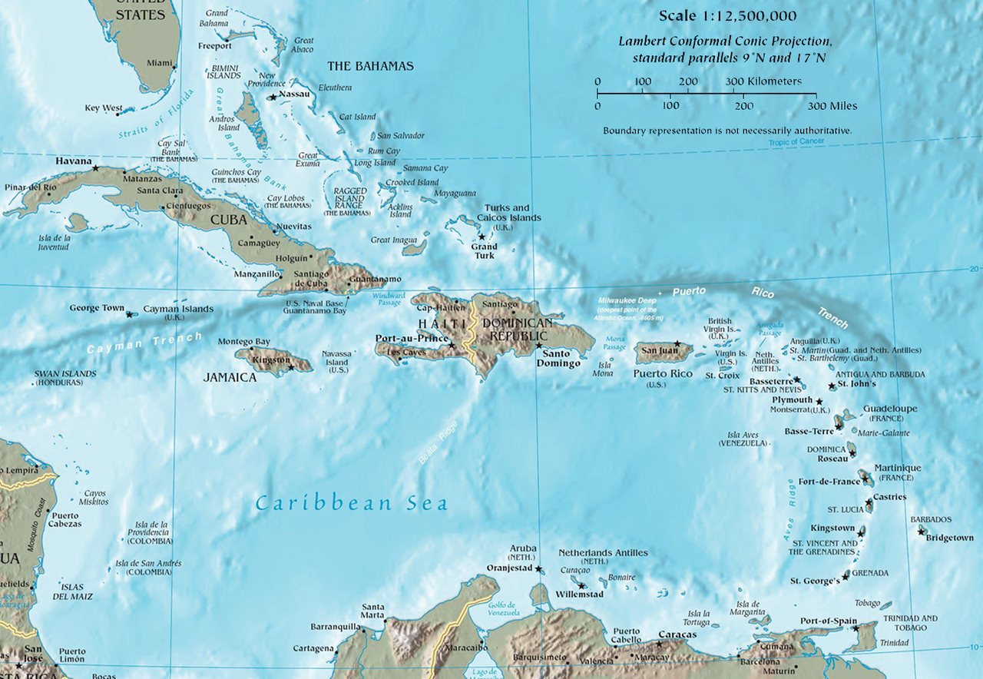
Notes:
Starting in 2019, I’ve been involved in several projects in the Bahama archipelago, also known as the Lucayan Islands.
This archipelago is interesting for a number of reasons. 1. It was one of the last places to settled in the Americas. The first folks reached it around 700 AD from the Greater Antilles, and evidence seems to suggest that there wasn’t a permanent population until around AD 900. The Lucayans, who lived here were largely wiped out by the Spanish invasion 600 years later.
While often glossed with the Caribbean, the archipelago is not part of the Caribbean, and people there developed their own distinct lifeways, while to some extent retaining connections with the Antilles. Geologically it is also distinct, being composed entirely of limestone while the Greater Antilles are dominated by volcanic and metamorphic formations. This means not only that the landforms are dramatically different, but also the vegetation and other biota. And as I’ll get to, the pottery as well.
Our research questions here have focused on understanding the lifeways of the Lucayans, the indigenous peoples of these islands, and their relationships within the broader circum-Caribbean. This research, led by Bill Keegan, was funded in part by National Geographic.

Slide 25
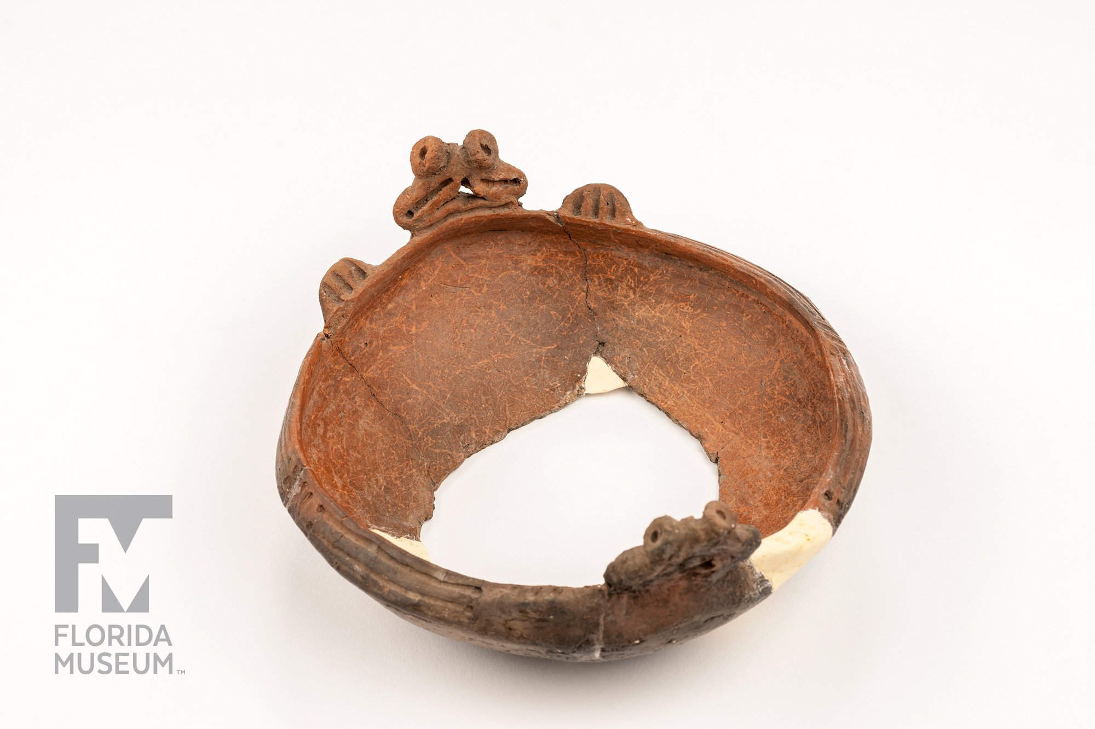
Notes:
The people who came to the Bahama archipelago brought pottery with them. At least at first. The imported pottery is very different from the locally made pottery, as I’ll explain in a moment, so it could be readily identified visually.
Here’s an example of a typical Chicoid bowl. In the volcanic islands of the greater Antilles there was abundant material for making pottery.
As part of this project, we conducted elemental analysis on imported wares found in the archipelago, compared with samples from across the Greater Antilles. The paper came out last week, in which, we determined that the majority of the imported pottery originated in Hispaniola. Notably, though Cuba is similarly close, they didn’t’ appear to have the same trade or travel connections. Incidentally, these results are also borne out by genetic evidence.
Here’s an example of a typical Chicoid bowl. In the volcanic islands of the greater Antilles there was abundant material for making pottery.

Slide 26
Notes:
However, Bahamas as I said, is entirely limestone. High calcium is typically disastrous for pottery. No geologically local raw material.

Slide 27
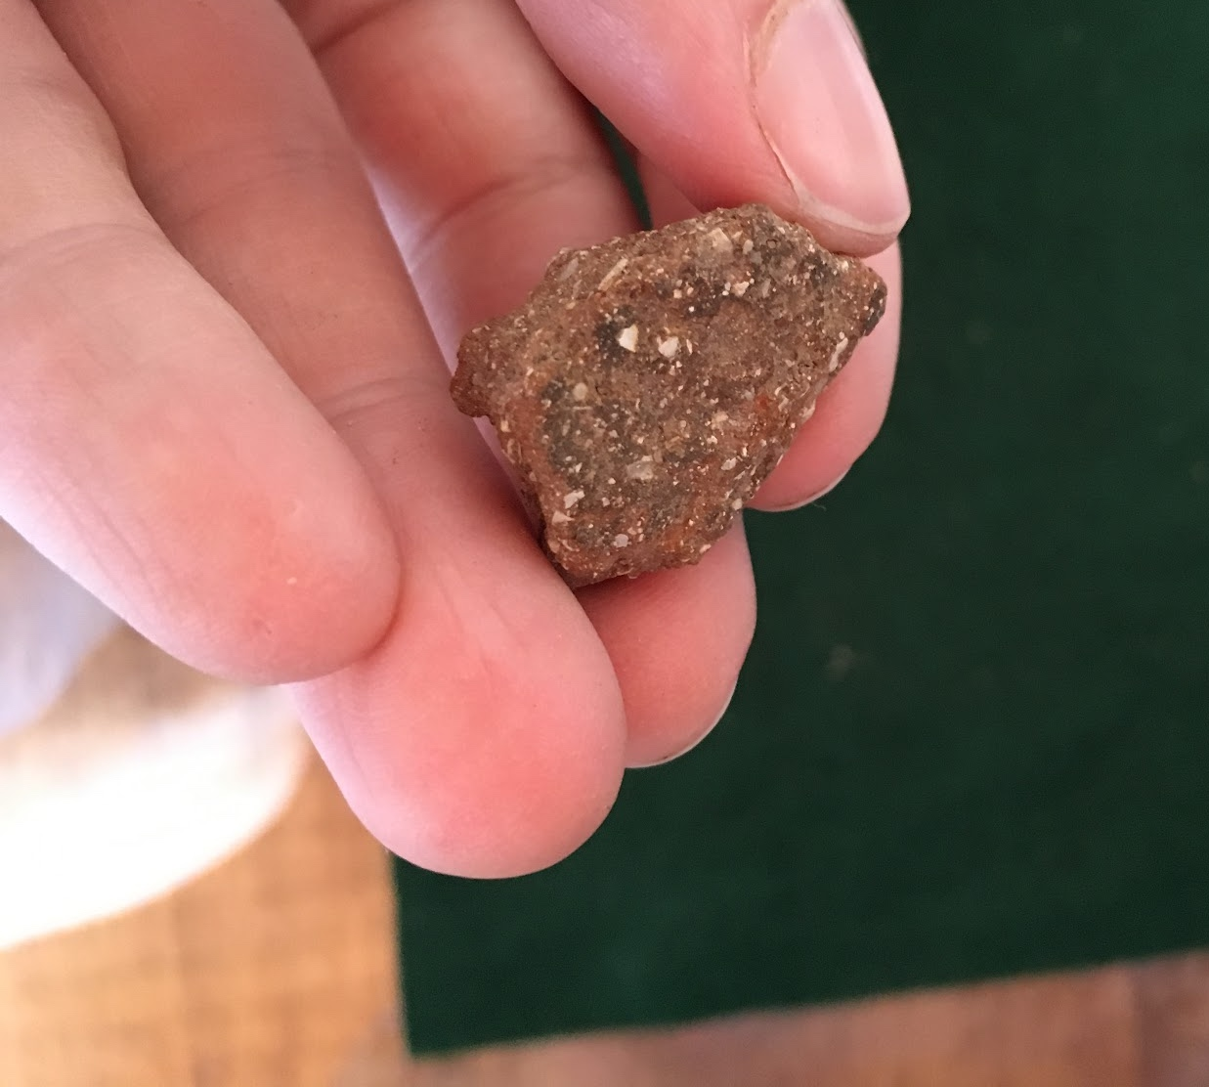
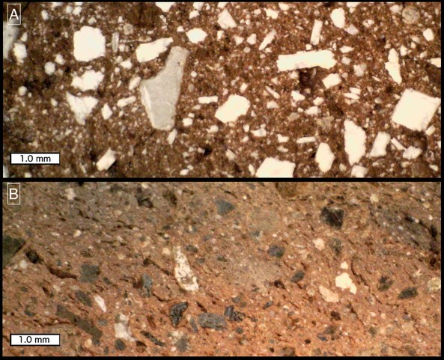
Notes:
And yet, we find locally made pottery. Several hundred years after the initial colonization, when there were permanent residents, known as the Lucayans. Often small and eroded like this example, PW is found only in the Bahama archipelago. Distinctive reddish color and white shell inclusions. No complete or even nearly complete PW vessel has ever been found. Because of its fragmentary nature, it hasn’t received much attention. It’s been viewed as sort of this inferior or expedient pottery.
So I just said that there’s no locally sources of clay, so what’s up/

Slide 28
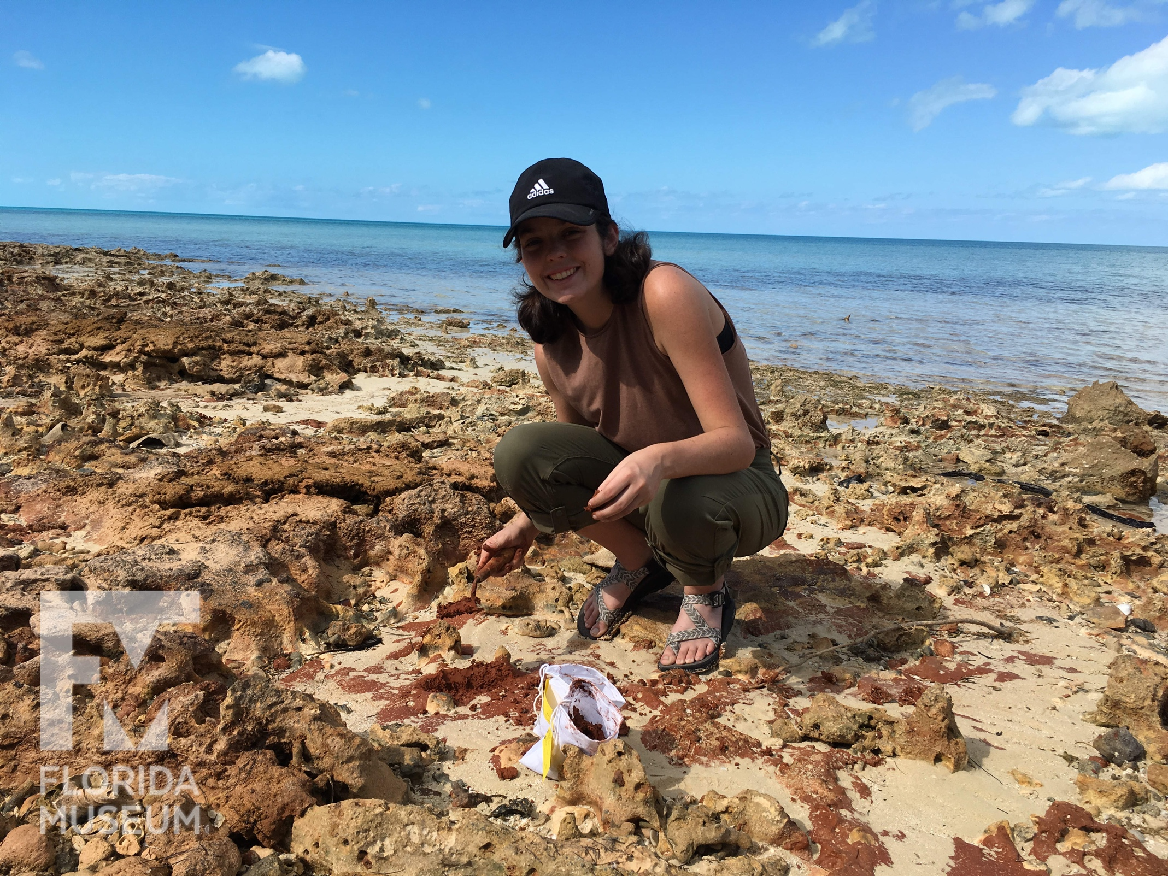
Notes:
As we were surveying the beaches and elsewhere, we encountered small deposits of bright red clayey material, which we collected.

Slide 29
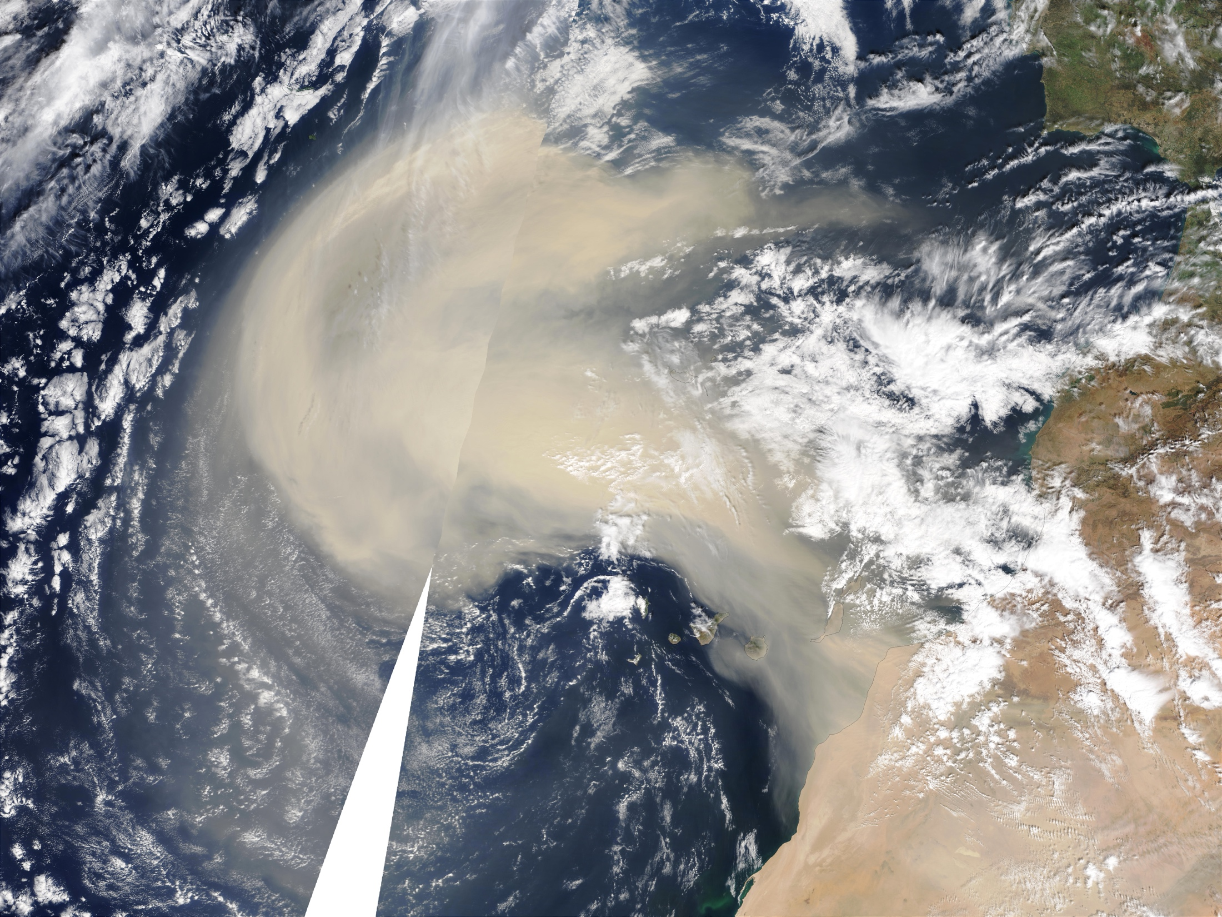
https://visibleearth.nasa.gov/images/92958/saharan-dust-over-the-atlantic/92960l
Notes:
This material is Saharan dust, aluminum and iron-rich laterite soil that is transported thousands of miles by wind, and has been deposited over long periods of time in the Bahama archipelago and other parts of the world.
We collected clay samples from the northern, central, and southern regions of the archipelago and brought them back to the lab to figure out what it actually was, if it could be used to make Palmetto Ware, and what sort of meaningful variation there was.

Slide 30
Bahama Red “Clays”
Notes:
First we did XRD to understand the mineralogy. We wanted to know what clay minerals were in it.
XRD is a mineralogical technique that relies on the crystalline structure of minerals. So essentially you shoot light at a sample and measure the angle that light diffracts, which is characteristic of a particular mineral. Here we used only clay sized fraction, so this is material that going by particle size could be called clay.
What we found was that the Saharan dust material was still more of a soil than clay. The highlighted area is where we would expect to see the common clay minerals used for pottery production? Kaolinite, illite, smectite. None of them are present. What is present are iron and aluminum minerals such as Bohmite, quartz, calcite, and a little bit of palygorrskit, which is a clay.
Makes sense for fine particles able to remain suspended across great distances. End up with something texturally similar to clay but lacking plasticity b/c it doesn’t have clay mineralogy
In the XRD diffractograms for the pottery itself, we saw these same peaks, confirming that this was the material used to make the pottery.
So next, we wanted to determine if we could tell where the pottery was made. To do that, we turned to mass spectrometry

Slide 31
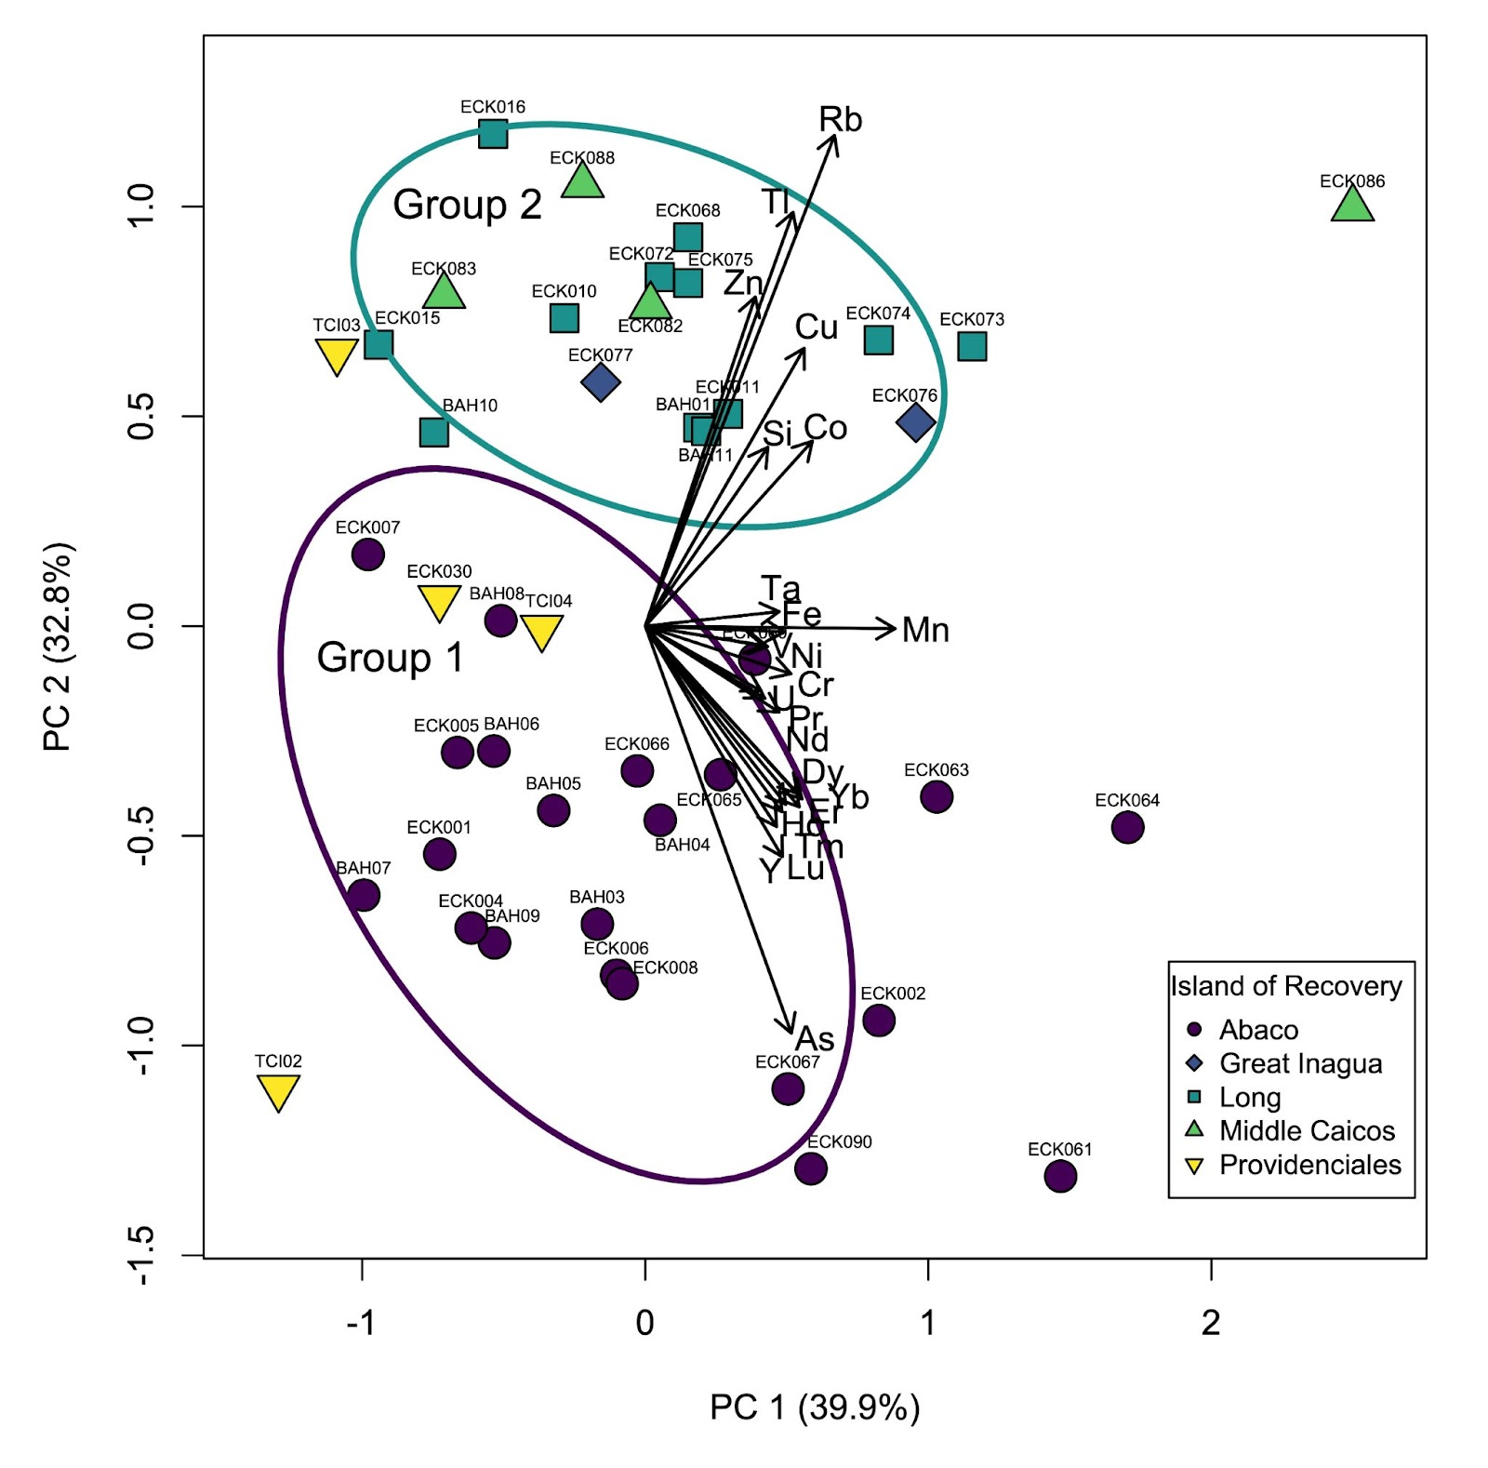
Notes:
We also conducted LA-ICP-MS, an elemental technique, on a larger sample of clays and pottery to see if the clay deposits were elementally consistent with the pottery. They were, and we recognized two geographic groups, one dominated by clays and pottery from the northern extent of the archipelago, and one from the central and southern. We haven’t pinned down the specific reason for this variation, which could be due to variation in wind patterns, or from differences in the micro-environments and weathering history on different islands.
So the mineralogical analyses and elemental analysis confirmed to us that the Saharan dust was used to make the pottery. But still, how, given that it isn't very plastic.

Slide 32



Mechanical Tests
Notes:
So now we moved into the replication part of the project
As we learned from the Xray diffraction, the clays aren’t mineralogically clay, but they have some of the textural qualities. But not quite enough. Short.
Needs something to hold it together and stop crack propagation. Normally would go for something like quartz sand, but there isn’t any.
Instead we know from the examples of palmetto ware, that they used shell, gastropod shell.

Slide 33
Notes:
Can’t use raw shell for a few reasons: it’s dense and hard to fracture. Sharp!
Aragonite is unstable at temperature and will cause pots to explode. It releases a lot of gas as it heats up, so it would be like putting popcorn in your clay.
BUT if you burn the shell first, you create the more stable calcite version of CaCO3. It will fracture readily into blocky bits. Voila, rock!
CaCO3
Aragonite to calcite

Slide 34

Notes:
So we burned some conch shell, crushed it, and added it to some of the clays we brought back. They improved the texture and made it possible to form briquettes. Less prone to cracking.
But there’s still a problem.
This is because above around 700°C, the calcium carbonate (CaCO3) converts into quicklime (CaO) and carbon dioxide (CO2). Quicklime is softer than calcium carbonate, so an overfired pot will feel light and fragile. Here’s an example showing how shell temper inclusions change with increasing temperature, with a major difference between 600°C and 700°C. Notice how the shell particles are more visible in the top two briquettes, both whiter and larger. Aside from temperature, the briquettes are identical.

Slide 35

Notes:
We usually think that hotter is better to make a stronger pot, but in this case it’s the opposite.
Vessels had to remain low fired, which means that they were softer and likely broke more readily than imported/Antillean wares.
But clearly the Lucayans figured this out, by the large quantities of Palmetto Ware we find.

Slide 36

Bloch, Lindsay, Emily Kracht, John Jaeger, and William F. Keegan
In Prep Palmetto Ware Pottery of the Lucayan Islands: Reverse Engineering a Novel Pottery Type.
Kracht, Emily C., Lindsay Bloch, William F. Keegan
2022 Production of Greater Antillean Pottery and its Exchange to the Lucayan Islands: A Compositional Study. Journal of Archaeological Science: Reports.
Notes:
recap the major challenges that people overcame in order to produce this pottery:
-more limited clayey resources, of poorer quality.
-no readily available tempering material to overcome that poor quality
-the temper they developed had a very narrow working range in terms of temperature.
There are a few minor variants of Palmetto Ware, but it is notable that the recipe is highly consistent across the whole archipelago, so whoever figured out the recipe, it spread and was maintained for hundreds of years.

Slide 37

Notes:
Finally, I want to give a plug for Indigenous knowledge. We went through this process of reverse-engineering to figure out this pottery type, without the benefit of local Indigenous people or a descendent community to talk to. But in many places there are still communities who know this information or are recovering it themselves, and we should be listening to and working with them. Finding out what they want to know and how we can help them.

Slide 38


What is clay?
A mineral?
A particle size?
A texture?
FIG. 6. Structural scheme of phyllosilicates. García-Romero and Suarez 2018 10.1180/minmag.2017.081.031
Notes:
Is clay a mineral: one of a family of hydrated silicates of alumina?
Is clay a particle size: the smallest grain sizes on the wentworth scale, invisible to the naked eye and imperceptible to the touch?
Is clay a texture: a body that is plastic and moldable?
The answer of course, all of the above, sometimess.

Slide 39

Clay Firing changes
Notes:
[Slide 7] The cooking analogy is particularly apt for pottery, as in both cases we’re taking ingredients and turning them permanently into something new.
And our studies start from the literal ground up, comparing available clays and other raw materials to archaeological pottery. For example, here are a selection of clay briquettes. Each column is a specific clay sample, the blocks at the bottom are unfired, then 400 degrees, 500, 600, up to 800 degrees Celsius. They’ve been test fired in our kiln to see how the clay behaves: how much it shrinks, the color it turns, its hardness, etc. From this we can tell if the clay would have been viable as pottery clay, and something about what the fired pottery may look like.

Slide 40

Inclusions/Temper
Notes:
Often, the working qualities of clay or pottery is improved by selecting clay that naturally has other materials in it. We call these inclusions. Organics tend to make more smooth and plastic, Hard parts, or aplastics, include things like rocks, especially sand-sized grains of quartz and other minerals.
We can use different microscopic techniques to identify inclusions in the clay body, like quartz and iron oxides. The shape of the individual grains and their amounts can sometimes help us pin down the place where a pot was made.

Slide 41

Clay vs. Clay Body
Notes:
Just so we’re all on the same page, let’s go over some vocabulary.
Clay the natural material, as removed from the ground, vs. cultural manipulation
We can use different microscopic techniques to identify inclusions in the clay body, like quartz and iron oxides. The shape of the individual grains and their amounts can sometimes help us pin down the place and time where a pot was made.

